Slide 1


Event Booking System with Ticketing and Scheduling.
Welcome to our comprehensive presentation on the Event Booking System with Ticketing and Schedulling utilizing the MERN stack (MongoDB, Express.js, React.js, and Node.js). This innovative solution offers a seamless approach to managing and booking events efficiently, catering to administrators, event organizers, and users alike.
Our system provides a robust platform for creating, managing, and participating in events with features such as user registration, dynamic event creation, real-time booking updates, and an intuitive interface. Join us as we explore how this MERN-based solution revolutionizes event management for the modern era.

Slide 2
System Overview and Specifications
Hardware Requirements
Software Requirements
Processor: Intel 3
Front End: React JS, CSS3, Bootstrap
Installed memory (RAM): 4 GB
Back End: Express JS, Node JS
Hard Disk: 500 GB
Database: MongoDB
Operating System: Windows 10 - 64 bit
Tools: Visual Studio Code

Slide 3



System Modules
Event Admin Module
Registration and Login
Create and manage event details
Manage ticket availability
View booking details and feedback
User Module
Registration and Login
Search events and check ticket availability
Make bookings and view booking history
Manage profile

Slide 4


Event Admin Module Details
Event Creation and Management
Ticket Management
Event owners can create detailed event listings including name, type, description, location, images, and price range. They can also update or delete events as needed.
Create and manage ticket availability, including type, price, and number of seats. Owners can update or delete ticket options to reflect changes in availability.
Booking and Feedback Overview
Profile Management
Access to view booking details for all events and read feedback provided by attendees, allowing for continuous improvement.
Event owners can update their profile details and change their account password for enhanced security.

Slide 5





User Module Features
Event Search
Booking System
Users can search for events by area, city, or any specific criteria, making it easy to find events that match their interests.
Check ticket availability and make bookings for selected events through a seamless interface.
Profile Management
Booking History
Users can update their profile details and change their account password, ensuring their information remains current and secure.
Access to view all past and upcoming bookings, providing a comprehensive overview of their event participation.

Slide 6
Admin Module and System Advantages
Admin Module Features
System Advantages
Secure login for administrative access
Efficiency and automation of event management tasks
Event approval process to ensure quality listings
Enhanced user experience with a centralized platform
User management capabilities
Real-time updates on ticket availability and event changes
Secure logout functionality
Improved data management and security
Scalability to handle growing user base and event listings

Slide 7

Comparison: Existing vs. Proposed System
Existing System Challenges
Proposed System Solutions
Manual, time-consuming processes
Automated, efficient event management
Fragmented user experience across multiple platforms
Centralized platform for seamless user experience
Limited accessibility and real-time updates
Real-time updates and improved accessibility
Data management and security concerns
Enhanced data security and management

Slide 8
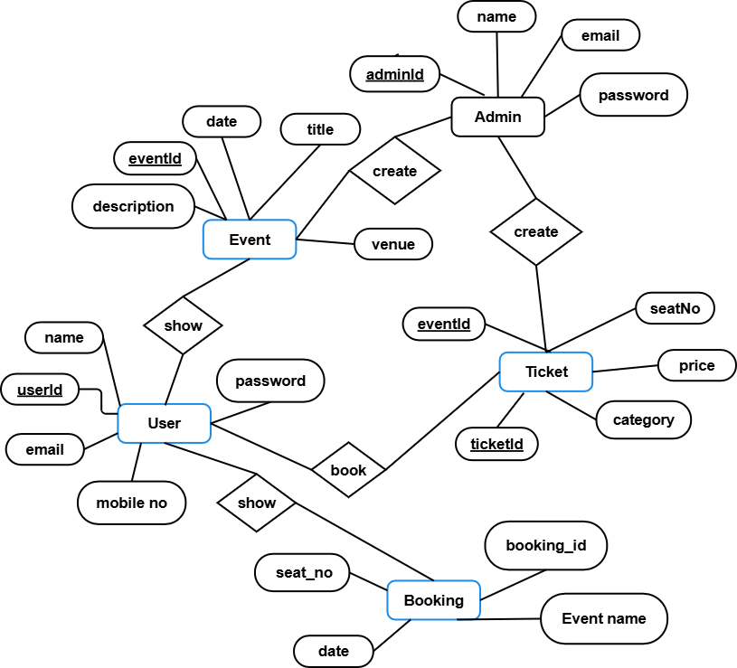
ER Diagram:
.

Slide 9
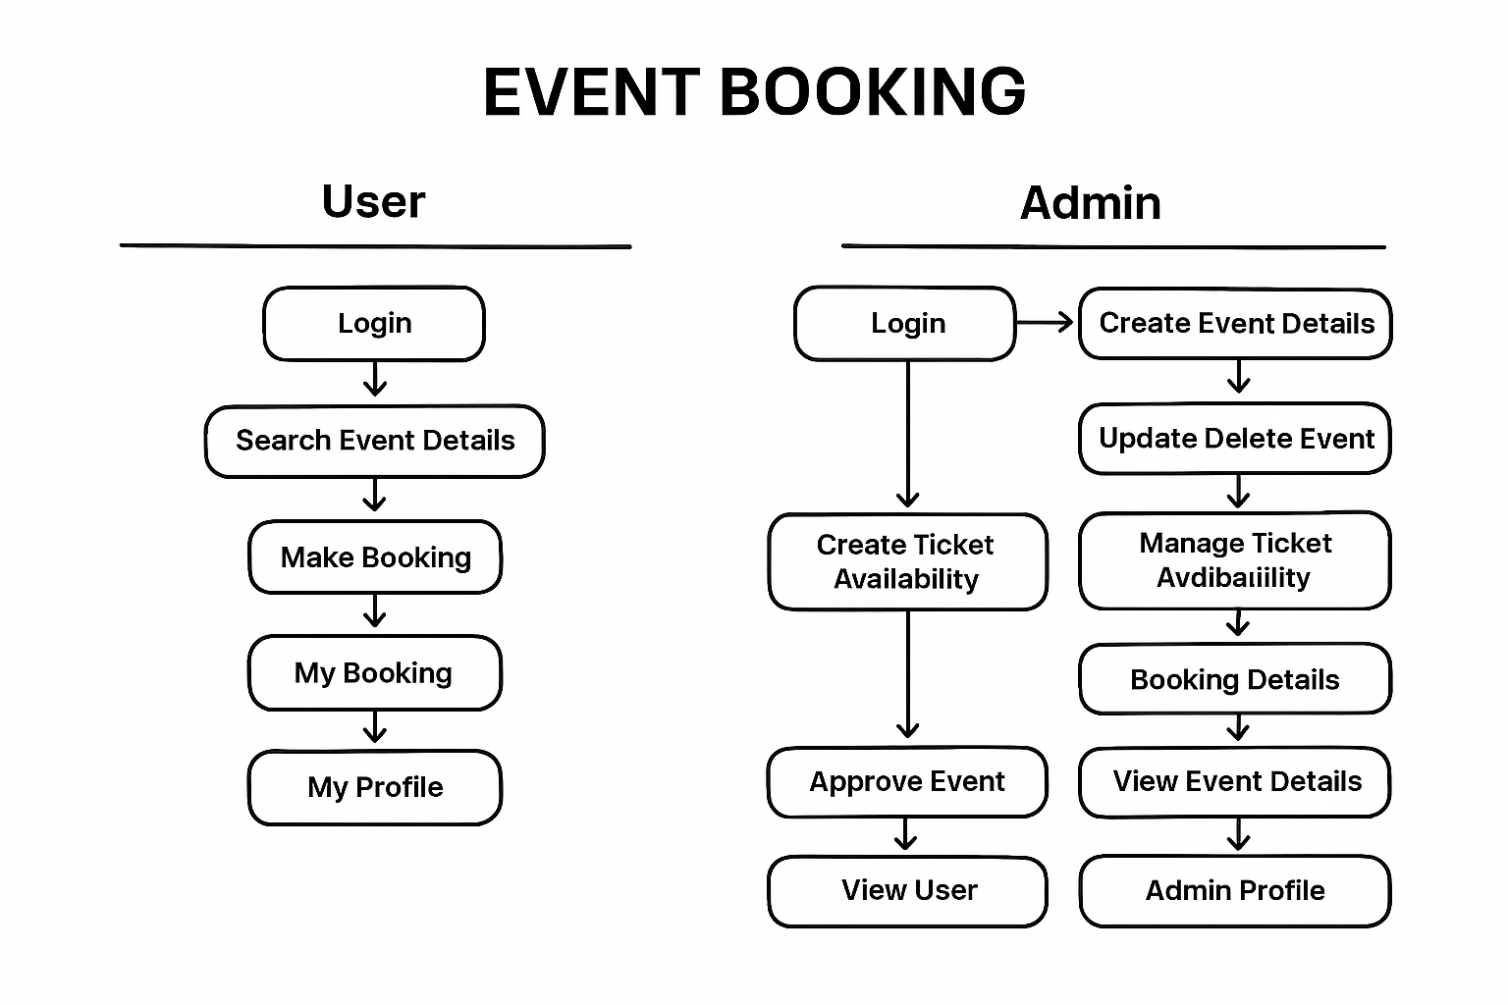
Flow diagram:

Slide 10
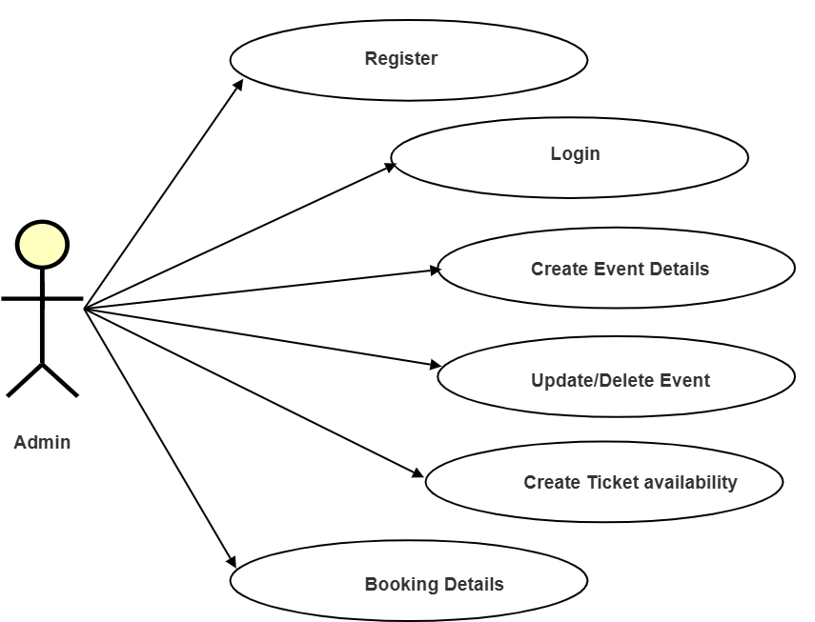
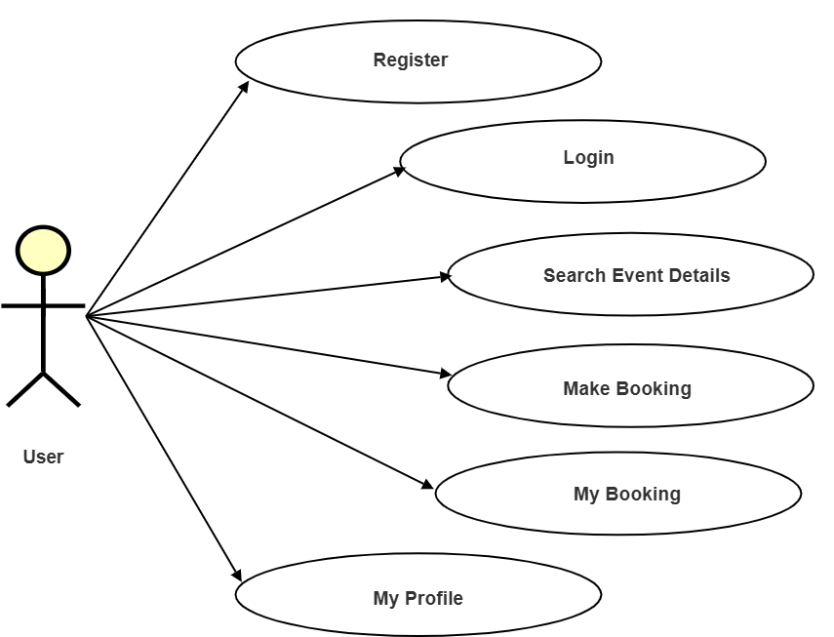
USECASE DIAGRAMS
EVENT ADMIN:
USER:

Slide 11
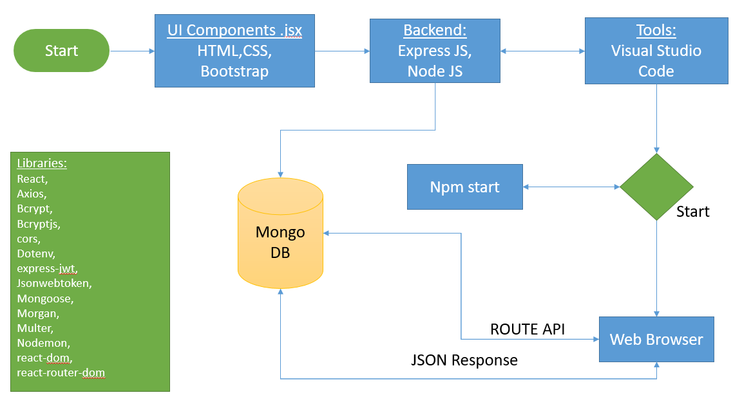
Work Flow Diagram:

Slide 12
Future Enhancements and Conclusion
1
Mobile Application Development
Dedicated apps for Android and iOS to enhance accessibility and user engagement.
2
Virtual and Hybrid Event Support
Expand capabilities to include virtual and hybrid event management.
3
Payment Integration for Ticketing
Paymennt Integration for secure and transparent ticketing processes.
In conclusion, the Event Booking Management system using the MERN stack offers a comprehensive solution to modernize event management. By addressing the limitations of existing systems and leveraging cutting-edge technologies, this platform is poised to revolutionize how events are organized, promoted, and attended. As we look to the future, continuous enhancements will ensure that the system remains at the forefront of event management technology, providing unparalleled value to organizers and attendees alike.

